Slide 1

Data Management Using Microsoft SQL Server
SQL
Server
2012
Session: 1
Introduction to the Web
Session: 3
Introduction to SQL Server 2012

Slide 2

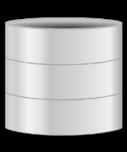

SQL
Server
2012
SQL
Server
2012
Describe the basic architecture of SQL Server 2012
List the various versions and editions of SQL Server
Explain the role and structure of SLQ Server databases
List the new features of SQL Server 2012
List the process of connecting to SQL Server Instances
Explain script file creation and organization
Explain the process to execute Transact-SQL queries

Slide 3

SQL
Server
2012
SQL
Server
2012
SQL Server is an RDBMS developed by Microsoft.
It provides an enterprise-level data management platform for an organization.
SQL Server includes numerous features and tools that make it an outstanding database and data analysis platform.
It is also targeted for large-scale Online Transactional Processing (OLTP), data warehousing, and e-commerce applications.
SQL Server 2012 is the new version of SQL Server and was launched by Microsoft
on March 6, 2012.
One of the major features of this version of SQL Server is that it is available on the cloud platform.
Using SQL Server 2012 not only helps an organization to store and manage huge amount of information, but also to protect and utilize this data at different locations as required.

Slide 4
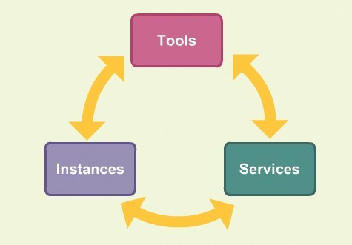
SQL
Server
2012
SQL
Server
2012
There are various components that form a part of SQL Server 2012.
All the components come together to form the basic architecture of SQL Server
2012.
These components can be represented under three major heads that are shown in the following figure:

Slide 5

SQL
Server
2012
SQL
Server
2012
There are a number of tools that are provided in SQL Server 2012 for development and query management of a database.
Following table lists the different tools available in SQL Server 2012.
Tool | Description
SQL Server Management Studio (SSMS) | One of the most important tools available in SQL Server 2012 is SSMS. Is an application provided with SQL Server 2012 that helps to create databases, database objects, query data, and manage the overall working of SQL Server.
SQLCMD | Is a command-line tool that can be used in place of SSMS. It performs similar functions as SSMS, but in command format only.
SQL Server Installation Center | Can also be used to add, remove, and modify SQL Server programs.

Slide 6

SQL
Server
2012
SQL
Server
2012
Tool | Description
SQL Server Configuration Manager | Is used by database administrators to manage the features of the SQL software installed in client machines. Is not available to all users. It can be used to configure the services, server protocols, client protocols, client aliases, and so on.
SQL Server Profiler | Is used to monitor an instance of the Database Engine or Analysis Services.
SQL Server Data Tools (SSDT) | Is an Integrated Development Environment (IDE) used for Business Intelligence Components. It helps to design the database using a tool named Visual Studio.
Connectivity Tools | Includes DB-Library, Open Database Connectivity (ODBC), Object Linking and Embedding Database (OLE DB), and so on. Are used to communicate between the clients, servers, and network libraries.

Slide 7

SQL
Server
2012
Some of the SQL Server 2012 services are as follows:
SQL Server Database Engine
Is a core service that is used for storing, processing, and securing
data.
Is also used for replication, full-text search, and the Data Quality Services (DQS).
Contains tools for managing relational and eXtensible Markup Language (XML) data.
SQL Server Analysis Services
Contain tools that help to create and manage Online Analytical Processing (OLAP).
Is used for personal, team, and corporate business intelligence
purposes.
Are also used in data mining applications.
Helps to collaborate with PowerPivot, Excel, and even SharePoint Server Environment.
SQL
Server
2012

Slide 8

SQL
Server
2012
SQL
Server
2012
SQL Server Reporting Services
Helps to create, manage, publish, and deploy reports.
Can use the reports in tabular, matrix, graphical, or free-form format.
Can also be created using Reporting Services.
SQL Server Integration Services
Are used for moving, copying, and transforming data using different graphical tools and programmable objects.
Includes DQS component in Integration Services.
Helps to build high-performance data integration solutions.
SQL Server Master Data Services
Are used for master data management.
Is used for analysis, managing, and reporting information such as hierarchies, granular security, transactions, business rules, and so on.

Slide 9

SQL
Server
2012
SQL
Server
2012
All the programs and resource allocations are saved in an instance.
An instance can include memory, configuration files, and CPU.
There can be multiple instances that can be used for different users in SQL Server 2012.
All instances work in isolation.
Each instance can be customized as per the requirement.
Even permissions for each instance can be granted on individual basis.
The resources can also be allocated to the instance accordingly, for example, the number of databases allowed.
Instances can be called as a bigger container that contains sub-containers in the form of databases, security options, server objects, and so on.

Slide 10
SQL
Server
2012
SQL
Server
2012
The first version of SQL Server was released in the year 1989.
After this, there have been new versions released almost every year, with the
latest one being SQL Server 2012.
Following table lists different versions of SQL Server:
Version | Year
SQL Server 1.0 | 1989
SQL Server 1.1 | 1991
SQL Server 4.2 | 1992
SQL Server 6.0 | 1995
SQL Server 6.5 | 1996
SQL Server 7.0 | 1998
SQL Server 2000 | 2000
SQL Server 2005 | 2005
SQL Server 2008 | 2008
SQL Server 2008 R2 | 2010
SQL Server 2012 | 2012

Slide 11
SQL
Server
2012
SQL
Server
2012
The main editions of SQL Server 2012 are as follows:
Enterprise
Is recurrently released edition on most versions of SQL Server.
Is the full edition of SQL Server which contains all the features of SQL Server 2012.
It supports features like PowerView, xVelocity, Business Intelligence services, virtualization, and so on.
Standard
Is the basic edition of SQL Server that supports fundamental database and reporting and analytics functionality.
It does not support critical application development, security, and data warehousing.
Business Intelligence
Is a new edition introduced for the first time in SQL Server 2012.
Supports basic database, reporting and analytics functionality, and also business
intelligence services.
Supports features such as PowerPivot, PowerView, Business Intelligence Semantic Model, Master Data Services, and so on.

Slide 12
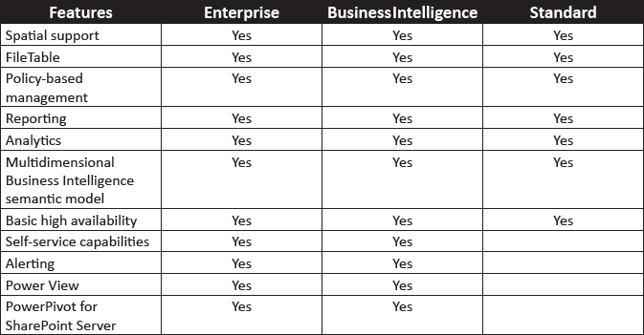
SQL
Server
2012
SQL
Server
2012
Following table shows a comparison of the features available for the different
editions of SQL Server 2012:

Slide 13
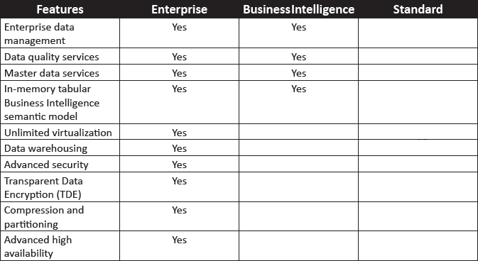
SQL
Server
2012
SQL
Server
2012
There are also other editions available such as:
Express edition - is a free edition of SQL Server 2012.
Web edition - is used for Internet-based Web services environment.
Developer edition - is used by programmers specifically for development, testing, and demonstration purposes.

Slide 14
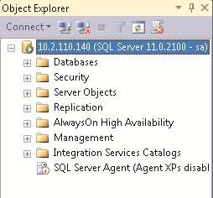
SQL
Server
2012
SQL
Server
2012
The structure of Object Explorer in SQL Server 2012 is shown in the following figure:
The structure includes databases, security, server objects, and replications.
It also includes features such as AlwaysOn High Availability, Management, Integration Services Catalogs, and so on.
14

Slide 15
SQL
Server
2012
SQL
Server
2012
The various components in the Object Explorer are as follows:
Databases
Contains a collection of databases that stores a specific set of structured data.
Security
Used to provide flexible and trustworthy security configuration in SQL Server 2012.
Includes logins, roles, credentials, audits, and so on.
Server Objects
Used to monitor activity in computers running an instance of SQL Server.
Replication
Used to copy and distribute data and database objects from one database to another,
and then, to synchronize between databases to maintain consistency.
AlwaysOn High Availability
Used for high availability and disaster recovery.
Is generally used for applications that require high uptime and failure protection.
Management
Used to manage policies, resources, events, maintenance plans, and so on.
Integration Services Catalogs
Stores all the objects of the project after the project has been deployed.

Slide 16
SQL
Server
2012
SQL
Server
2012
Statistics properties
Failover clustering enhancements SQL Azure
Data-tier Applications
Data Quality Services
Big data support
SQL Server Installation
Server mode
Audit features Selective XML Index Master Data Services PowerView
Full Text Search

Slide 17
SQL
Server
2012
SSMS is used to connect to SQL Server instances.
SSMS is a tool used for creating, querying, and managing the databases.
To open SSMS, connect to SQL Server 2012 by specifying the sever information and login credentials which includes username and password.
The detailed steps to connect to SQL Server instance are as follows:
SQL
Server
2012
Click Start → All Programs → Microsoft SQL Server 2012 → SQL Server
Management Studio.
1
In the Connect to Server dialog box, select the Server type as Database Engine.
2
3
Type the Server name.
Select either Windows Authentication or SQL Server Authentication, provide the required Login and Password, and click Connect.
4

Slide 18
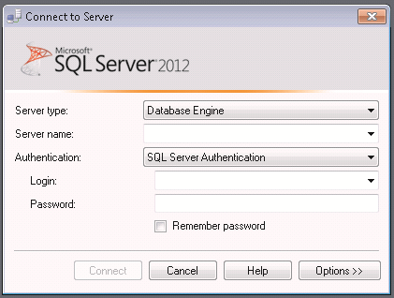
SQL
Server
2012
SQL
Server
2012
Following figure shows the Connect to Server dialog box:

Slide 19
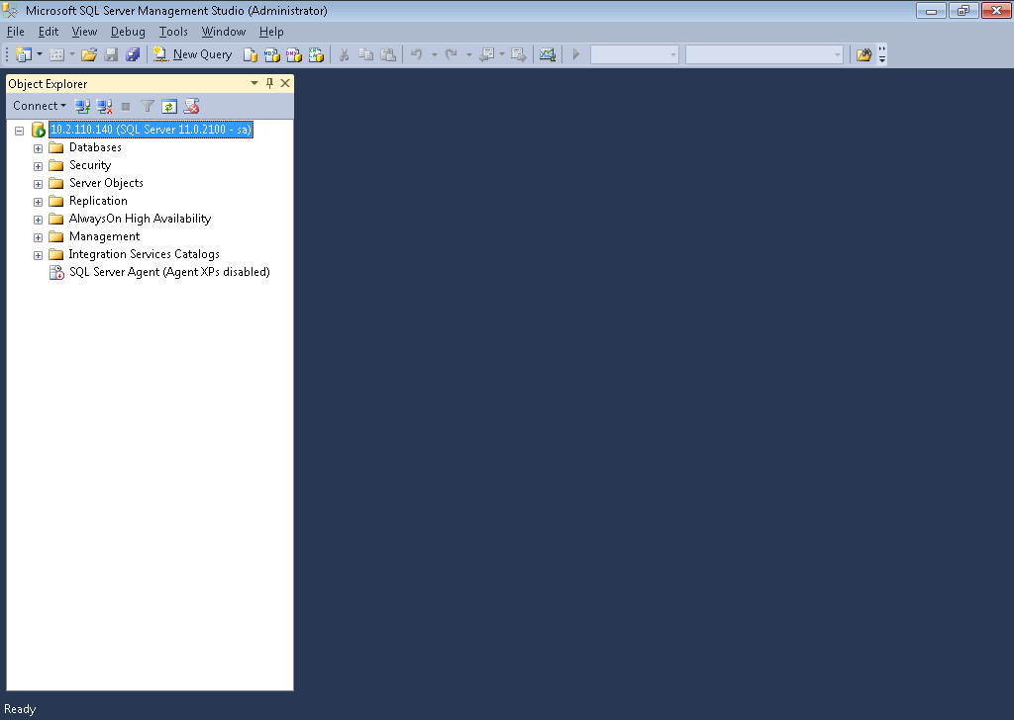
SQL
Server
2012
SQL
Server
2012
Following figure shows the SSMS window:

Slide 20
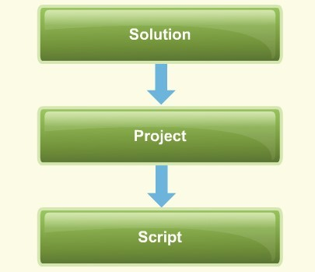
SQL
Server
2012
SQL
Server
2012
Script files are files that contain a set of SQL commands.
The script files are stored in .sql format in SQL Server 2012.
The conceptual layers in which the script files must be organized are shown in the
following figure:

Slide 21


SQL
Server
2012
SQL
Server
2012
A solution is a file in which all the projects in SQL Server 2012 are saved.
A project comes under a solution node and there can be more than one project in SQL Server 2012.
The script files are the core files in which the queries are developed and executed.
The scripts have a .sql extension.

Slide 22
SQL
Server
2012
SQL
Server
2012
The queries typed in Transact-SQL and saved as .sql files can be executed directly in the SSMS query window.
The steps to execute Transact-SQL queries are as follows:
In the query window, select the code to be executed.
1
On the SSMS toolbar, click Execute. OR
On the Query menu, click Execute. OR
Press F5 or Alt+X or Ctrl+E.
2

Slide 23
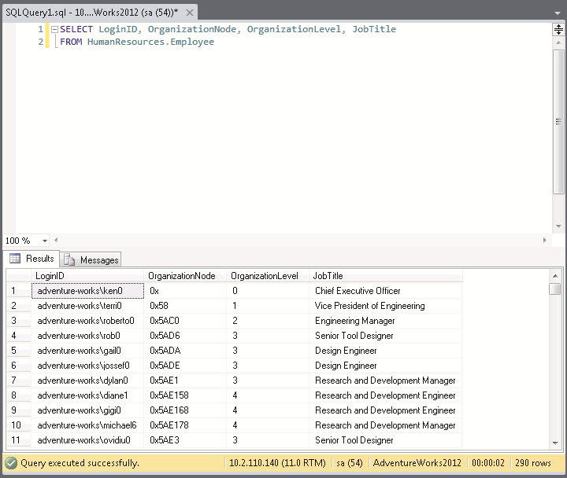
SQL
Server
2012
SQL
Server
2012
Following figure shows the results of a sample executed query.
The query results can be displayed in three different formats namely, grid, text, and file view.

Slide 24

SQL
Server
2012
The basic architecture of SQL Server 2012 includes tools, services, and instances.
The three editions of SQL Server are Enterprise, Standard, and Business Intelligence.
The structure of SQL Database includes databases, security, server objects, replications, AlwaysOn High Availability, Management, Integration Services Catalogs, and so on.
SSMS is used to connect to SQL Server Instances.
SSMS is a tool used for developing, querying, and managing the databases.
The script files should be stored in .sql format in SQL Server 2012.
The queries typed in Transact-SQL and saved as .sql files can be executed directly into
the SSMS query window.
SQL
Server
2012

